Slide 1
ISO31000:2018 – RISK MANAGEMENT – FRAMEWORK
A Risk Practitioners Guide To ISO31000:2018
https://www.theirm.org/media/3513119/IRM-Report-ISO-31000-2018-v3.pdf

Slide 2
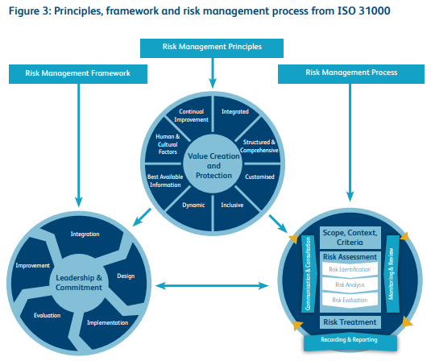
ISO31000:2018 – RISK MANAGEMENT – FRAMEWORK

Slide 3
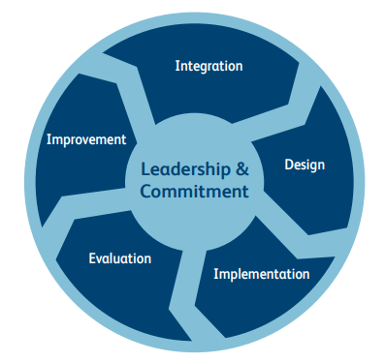
ISO31000:2018 – RISK MANAGEMENT – FRAMEWORK
Framework
5 components

Slide 4
ISO31000:2018 – RISK MANAGEMENT – FRAMEWORK
The principles of risk management and the framework are closely related.
For example, one of the principles is that risk management should be integrated and one of the components of the framework is integration.

Slide 5
ISO31000:2018 – RISK MANAGEMENT – FRAMEWORK
The principle outlines what must be achieved, and the framework provides information on how to achieve the required integration.

Slide 6
ISO31000:2018 – RISK MANAGEMENT – FRAMEWORK
The ISO 31000 guidelines are centered on leadership and commitment.
The effectiveness of risk management will depend on its integration into all aspects of the organization, including decision-making.

Slide 7
ISO31000:2018 – RISK MANAGEMENT – FRAMEWORK
The remaining components of the framework are design, implementation, evaluation and improvement. This approach is often represented in management literature as plan-do-check-act.

Slide 8
ISO31000:2018 – RISK MANAGEMENT – FRAMEWORK
ISO 31000 provides narrative description of how the framework should support risk management activities in an organization.
This is often referred to as the risk architecture, strategy and protocols of the organization, as set out in Table 2.

Slide 9
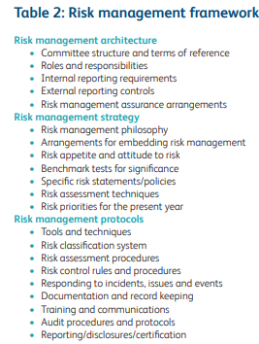
ISO31000:2018 – RISK MANAGEMENT – FRAMEWORK
RISK
MANAGEMENT
FRAMEWORK
ARCHITECTURE
STRATEGY
PROTOCOLS

Slide 10
ISO31000:2018 – RISK MANAGEMENT – FRAMEWORK
A Risk Practitioners Guide To ISO31000:2018
https://www.theirm.org/media/3513119/IRM-Report-ISO-31000-2018-v3.pdf
END

